Slide 1
2024-06-27_S16-S17-S18-S19
S1x_Icell_t1800_C0010_J01
Gottfrid Olsson

Slide 2
Goals with this session
Reproducibility after changes to method: are the properties of the samples the same? If they differ, how?
SEM images in a 4x4 grid for image analysis
Test of 4x4 sampling
Images for training (images taken close to the grid-images)
Images for analysis (4x4 grid)

Slide 3
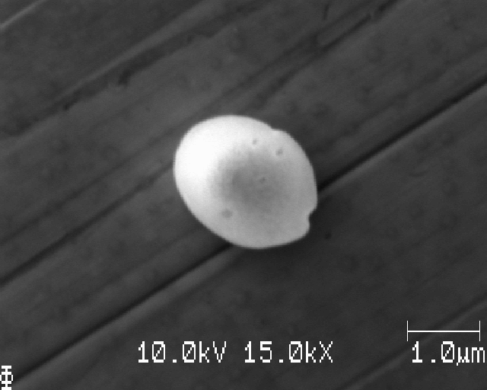
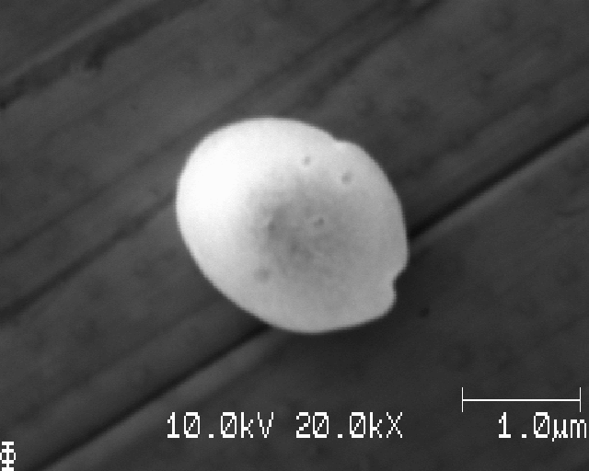
I’ll use 10kV3.0nA
Nice imaging achieved:

Slide 4
S16_Icell_t1800_C0010_J01
Cu polished to P4000 then electropolished

Slide 5
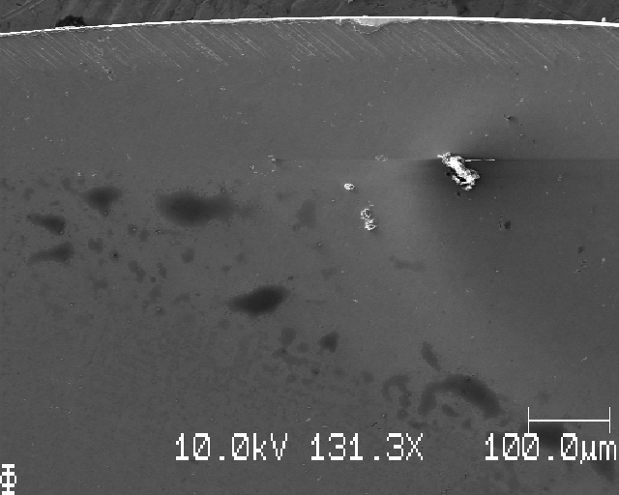
S16: top edge

Slide 6
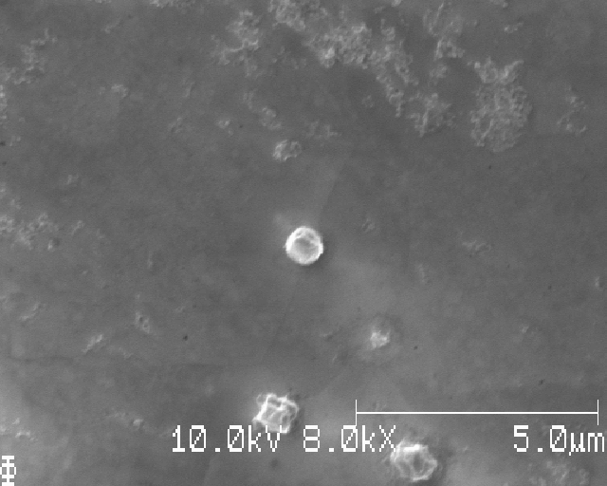
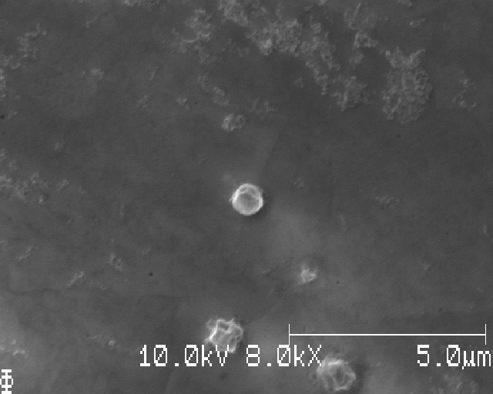
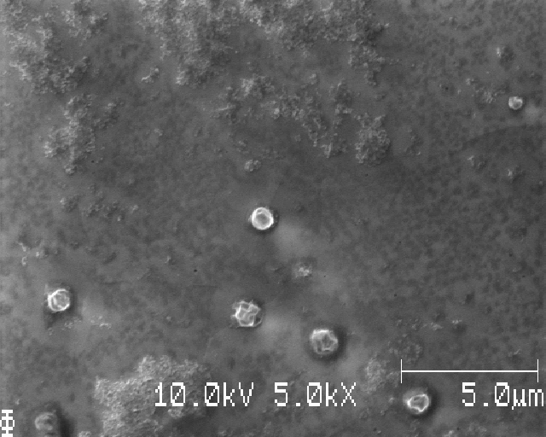
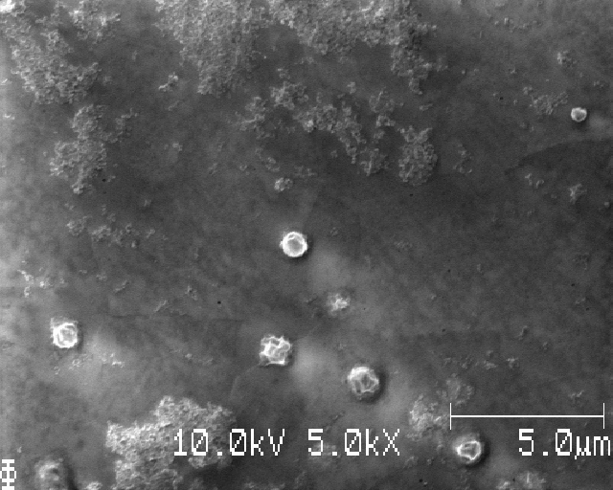
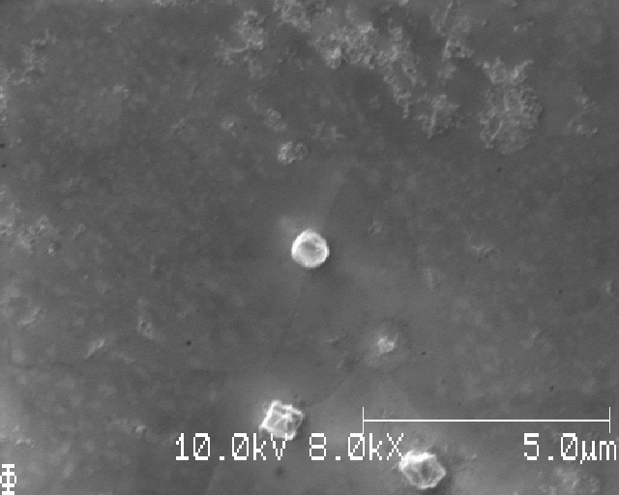
Testing different SED multiplier V and contrast, brightness

Slide 7
Testing different SED multiplier V and contrast, brightness
For now, 10kV, 3nA
SED multiplier voltage 1560
Contrast 30 %, brightness 71% coarse, 45% fine

Slide 8
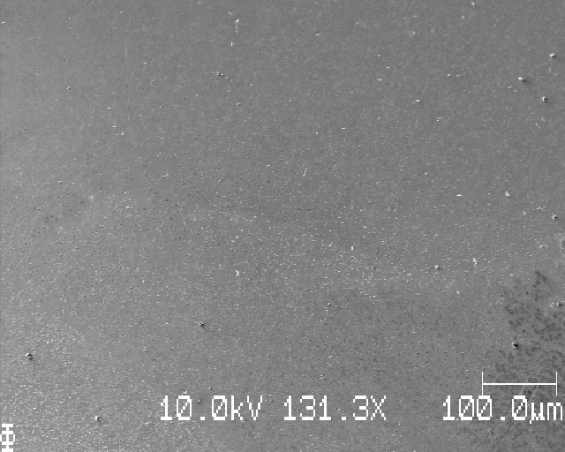
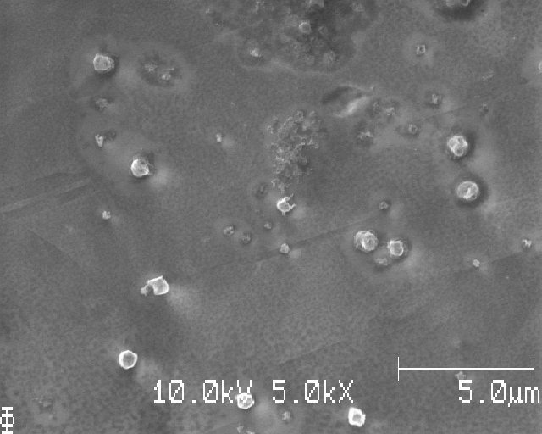
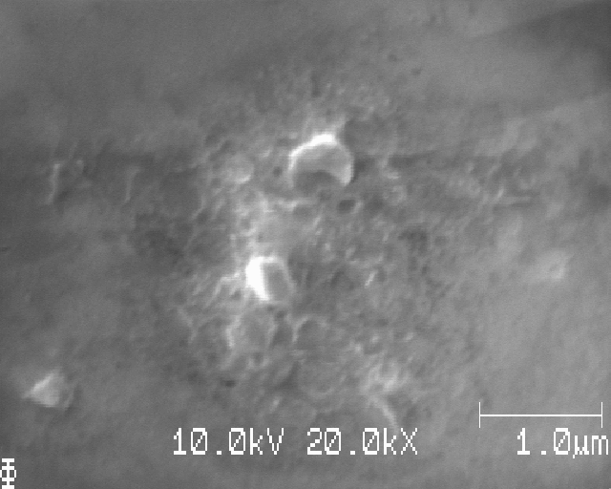
S16: moving down; edge of deposition
Notes:
Clear halo around Li nuclei; flackig Cu yta, pga elektropolering?

Slide 9
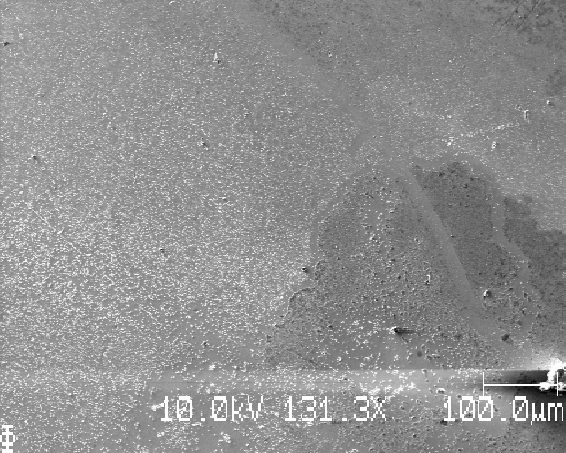
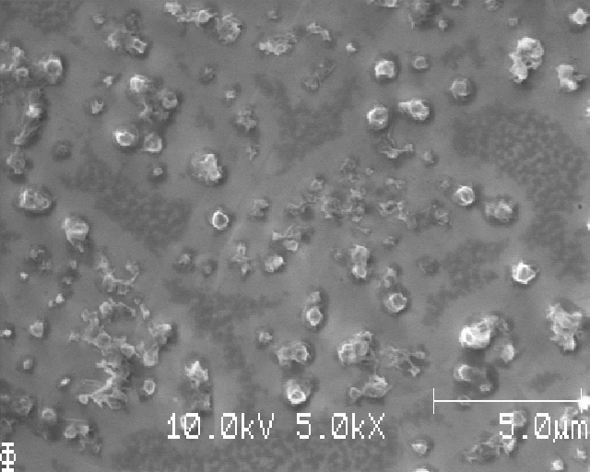
S16: down, uneven deposition

Slide 10
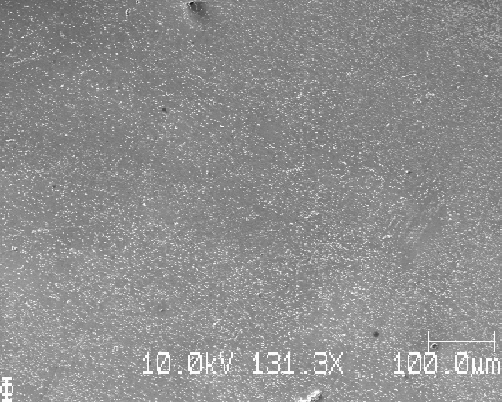
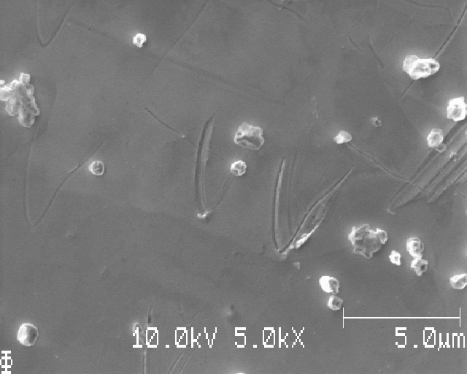
S16: down, right: pretty even deposition

Slide 11
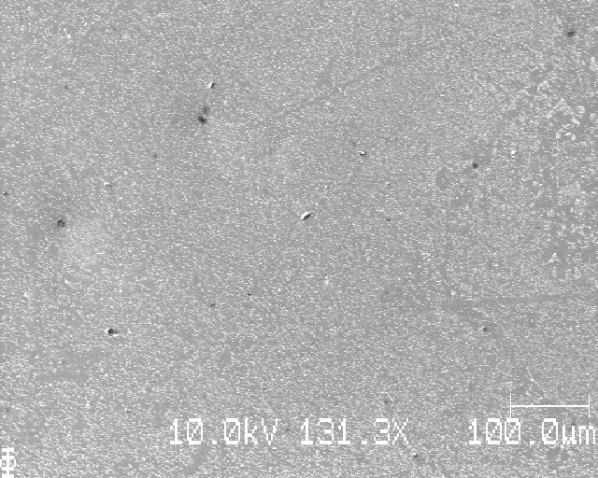
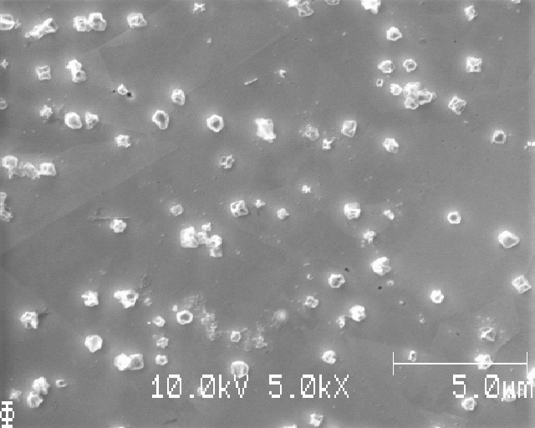
S16: down

Slide 12
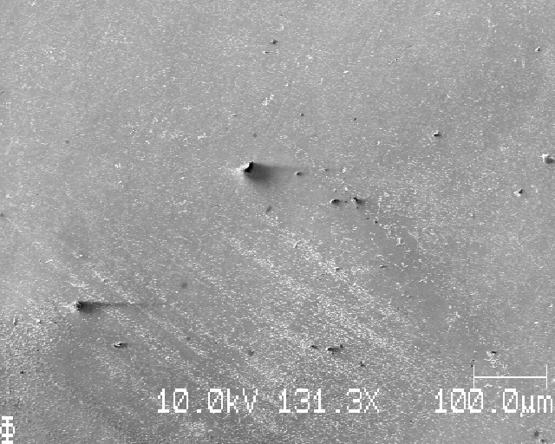
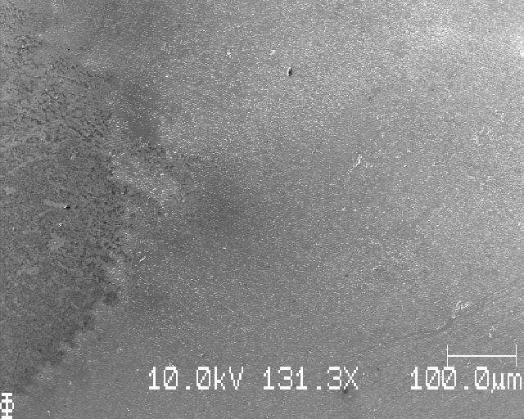
S16: down, less even deposition; also streaks of Li: left picture is further down

Slide 13
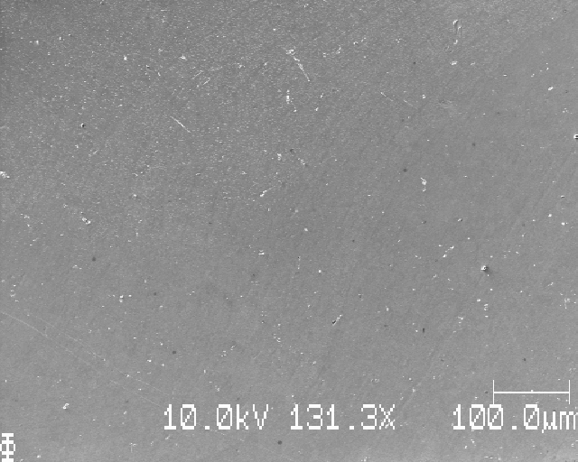
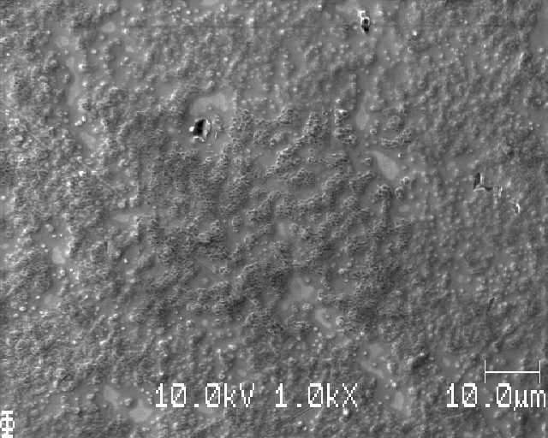
S16: down; left: up and left – bubbles, locally bad wash

Slide 14
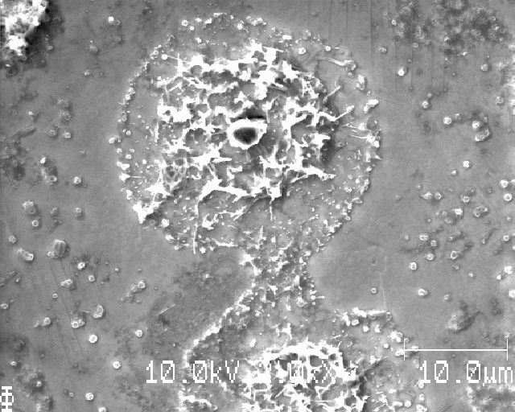
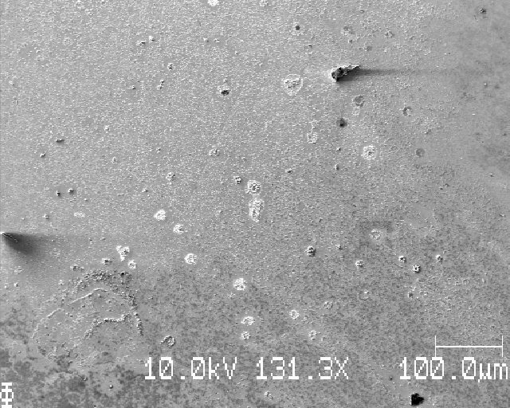
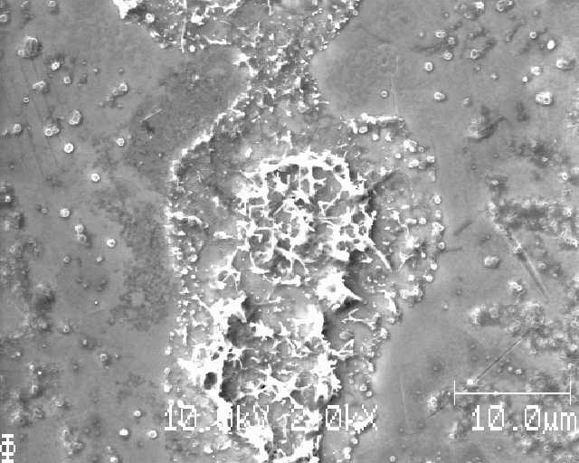
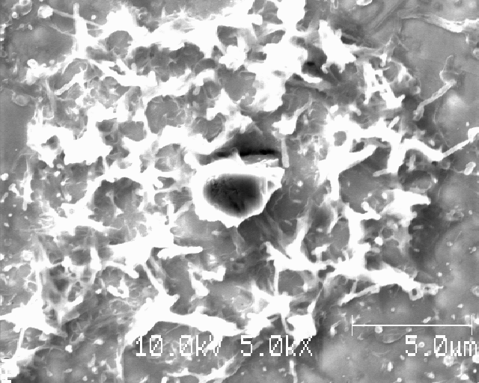
S16: up, left

Slide 15
S16: grid SEM images squares, dx=dy=750mu

Slide 16
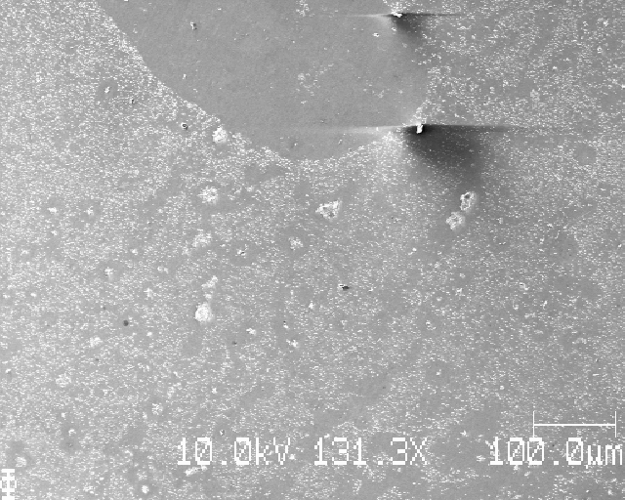
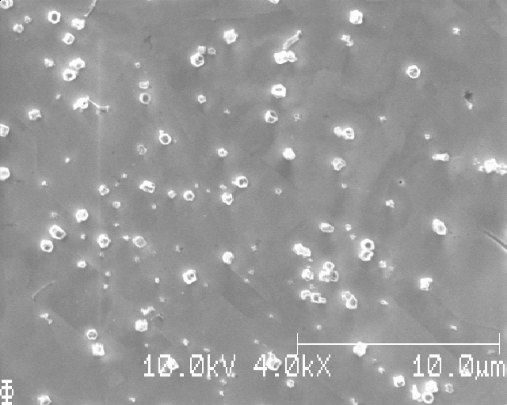
Position 1 of 16 (I’ll take zoomed out pics too, until we know that the deposition is even)
Notes:
Löpande nummer: 1

Slide 17
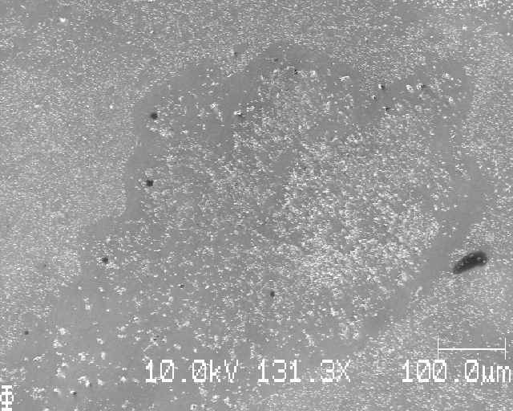
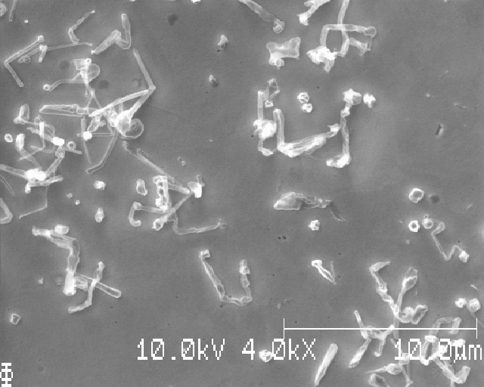
Position 2 of 16
Notes:
Löpande nummer: 2

Slide 18
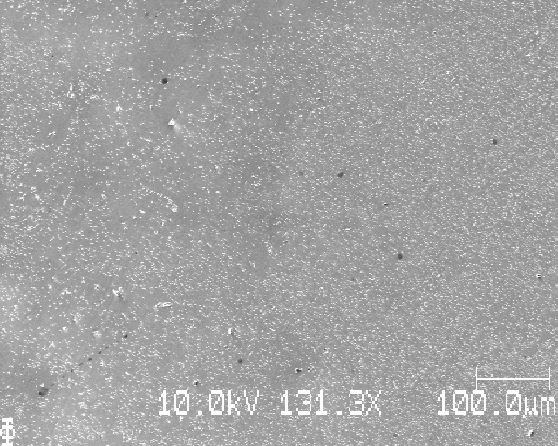
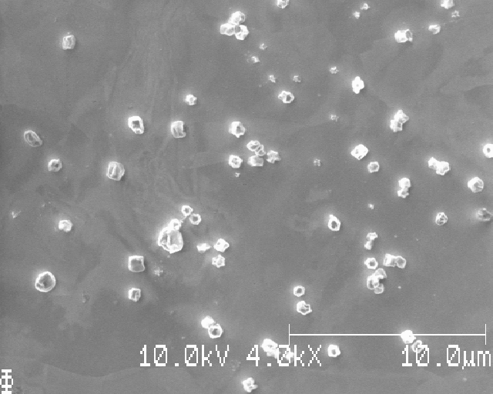
Position 3 of 16
Notes:
Löpande nummer: 3

Slide 19
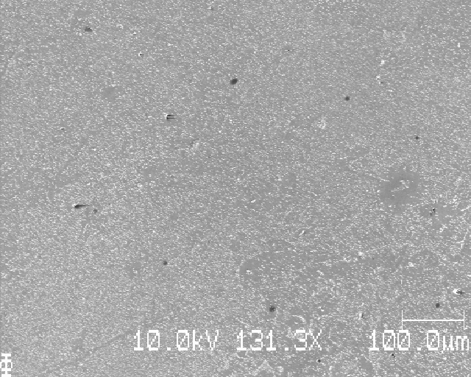
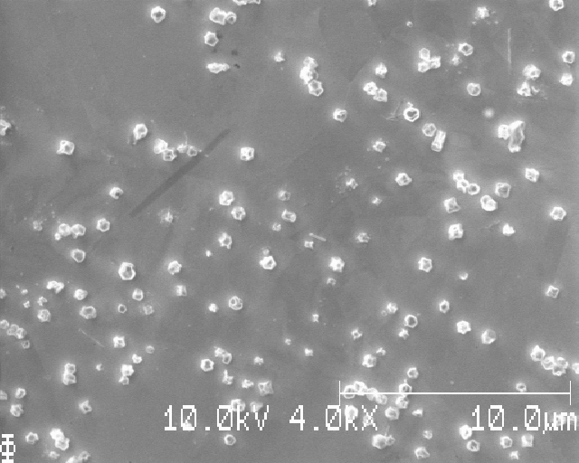
Position 4 of 16
Notes:
Löpande nummer: 4

Slide 20
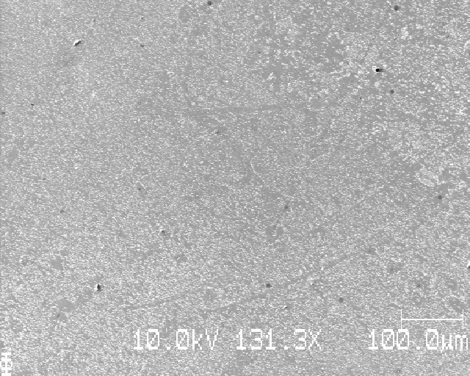
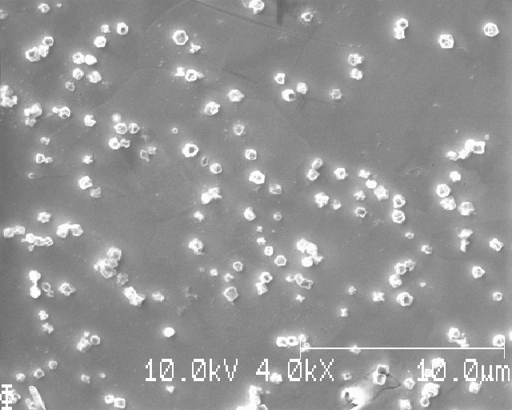
Position 8 of 16
Notes:
Löpande nummer: 5

Slide 21
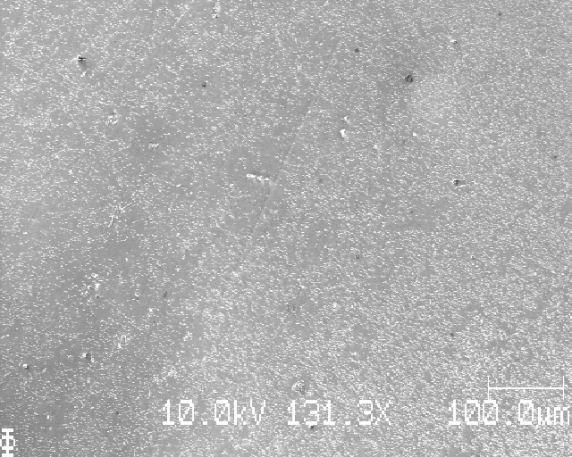
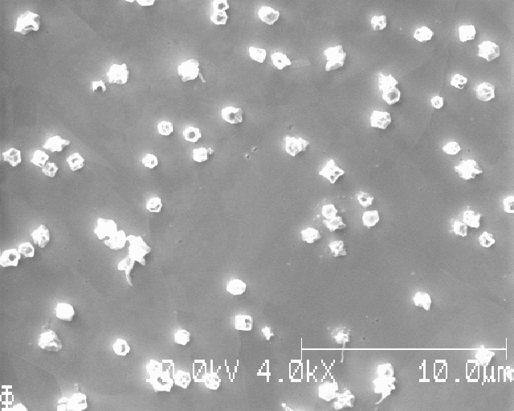
Position 7 of 16
Notes:
Löpande nummer: 6

Slide 22
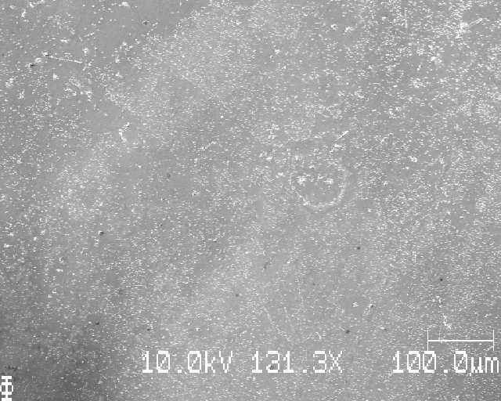
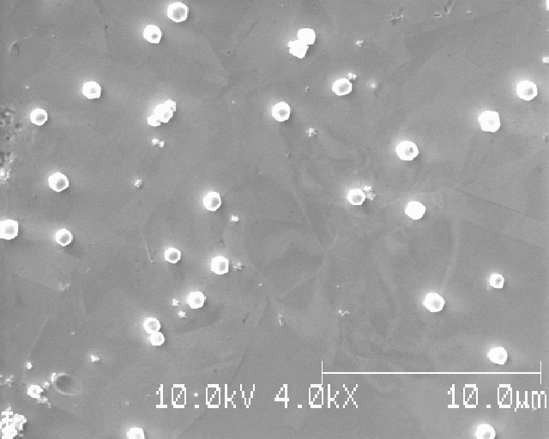
Position 6 of 16
Notes:
Löpande nummer: 7

Slide 23
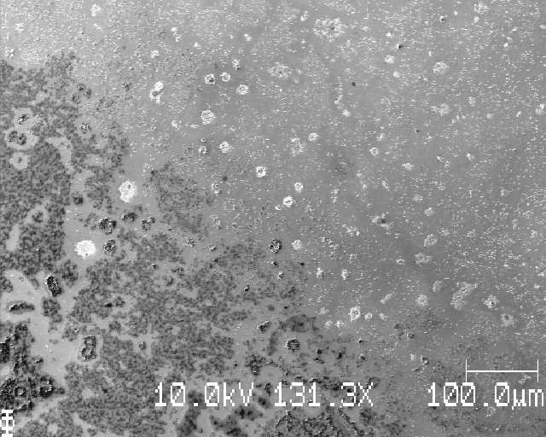
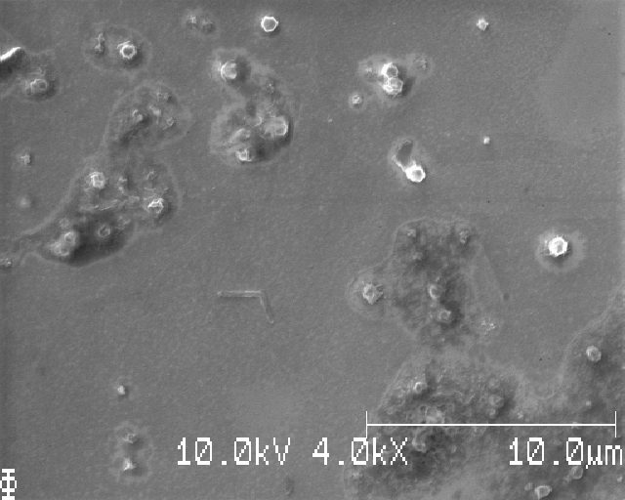
Position 5 of 16
Notes:
Löpande nummer: 8

Slide 24
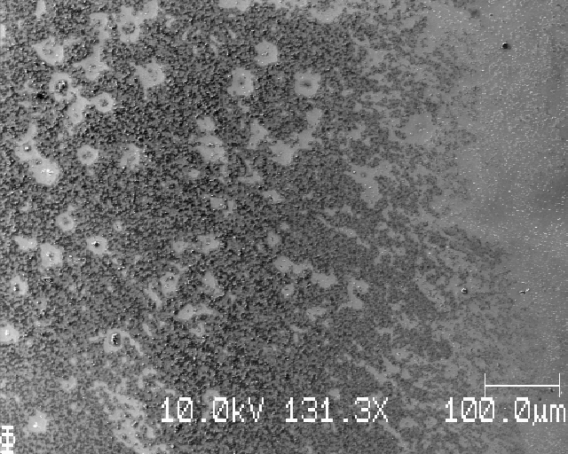
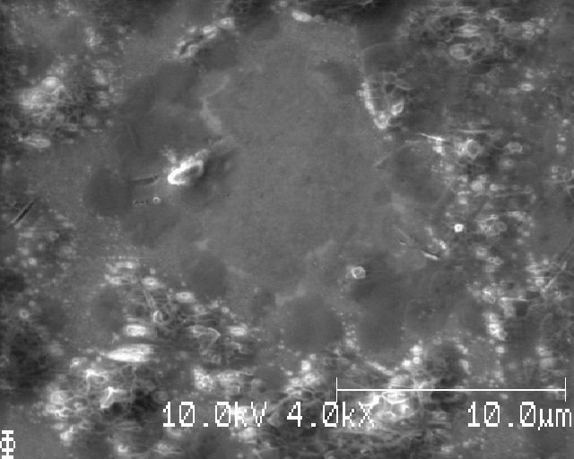
Position 9 of 16
Notes:
Löpande nummer: 9

Slide 25
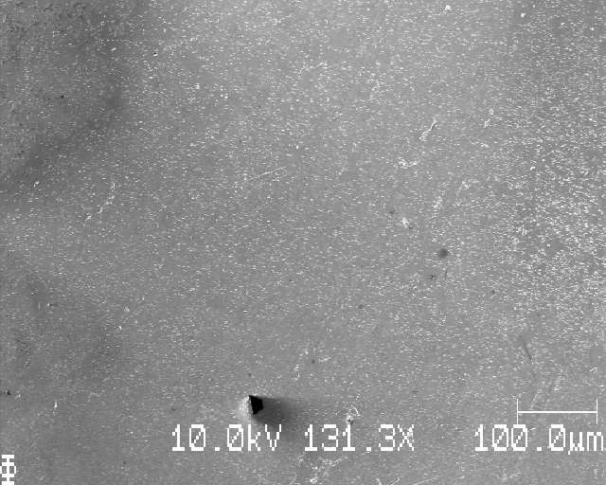
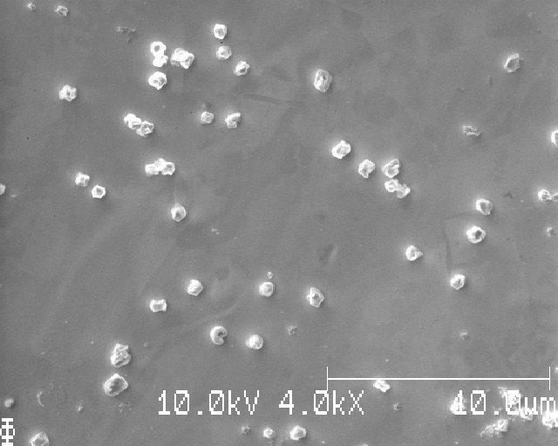
Position 10 of 16
Notes:
Löpande nummer: 10

Slide 26
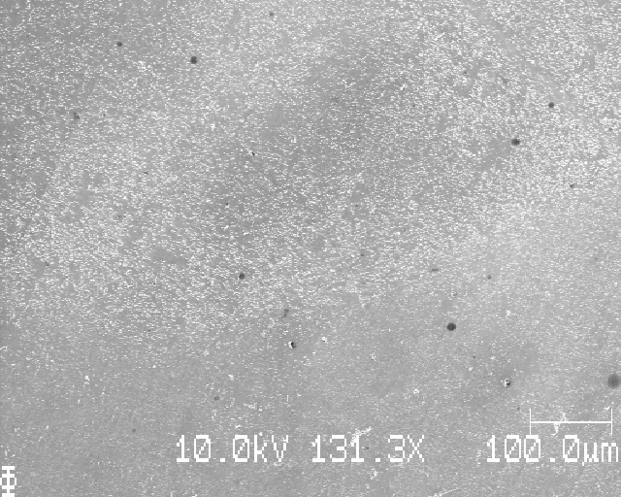
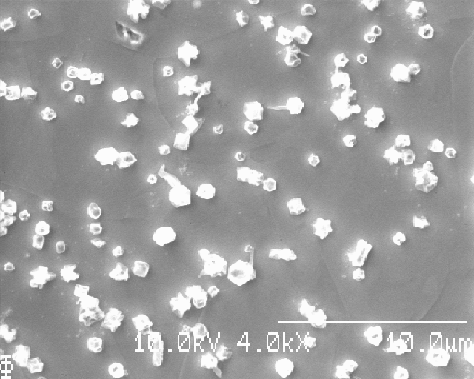
Position 11 of 16
Notes:
Löpande nummer: 11

Slide 27
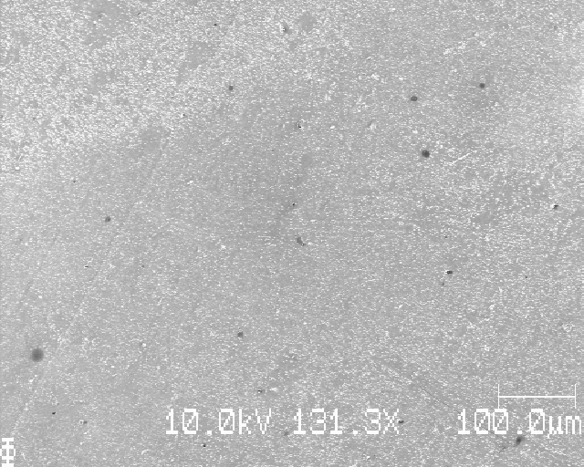
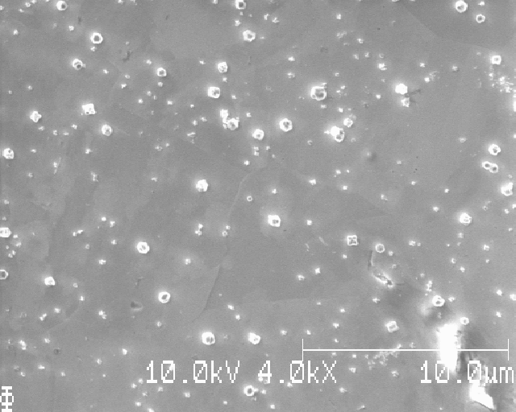
Position 12 of 16
Notes:
Löpande nummer: 12

Slide 28
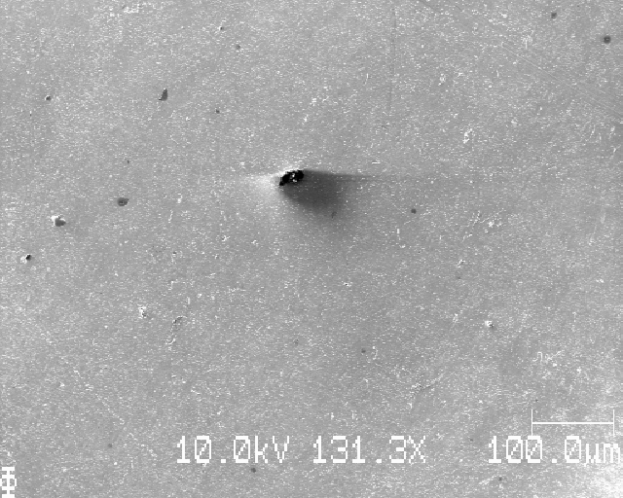

Position 16 of 16
Notes:
Löpande nummer: 13

Slide 29


Position 15 of 16
Notes:
Löpande nummer: 14

Slide 30


Position 14 of 16
Notes:
Löpande nummer: 15

Slide 31


Position 13 of 16
Notes:
Löpande nummer: 16 (slut); shiet, bubblade vid zoom-in

Slide 32



S16: some AI training images, taken at spots with clear Li/Cu separation (around point 8)
Notes:
Löpande nummer: 16 (slut)

Slide 33
S16: learning points
Li deposition pretty okay evenly distributed
Although some parts barren of Li
Washing is still weird with some parts covered in shite, but most of this sample looked good
4x4 grid sampling seems even better than 3x3 and won’t take that long if only the zoomed-in image is taken
The long time waste is waiting for the SmartSoft program

Slide 34
(next sample)

Slide 35
S17_Icell_t1800_C0010_J01
Cu polished to P4000 then to 0.25 microns diamond slurry

Slide 36


S17: top edge, grinding marks visible
Notes:
Clear difference between EP samples and not EP (only mechanical polishing)

Slide 37


S17: down, Li stripes (why?)

Slide 38


S17: down; left; down, right (still stripes)

Slide 39


S17: down

Slide 40
S17: grid SEM images squares, dx=dy=1000mu
This sample won’t give good analysis since the Li is so uneven
Taking 3x3 pictures zoomed out for reference of uneveness

Slide 41


Position 5 of 9
Notes:
Löpande nummer: 1

Slide 42

Position 6 of 9

Slide 43

Position 3 of 9

Slide 44

Position 2 of 9

Slide 45

Position 1 of 9

Slide 46

Position 4 of 9

Slide 47

Position 7 of 9

Slide 48

Position 8 of 9

Slide 49

Position 9 of 9

Slide 50
S17: learning points
Only mechanical polishing, even to 0.25 microns diamond slurry, results in clearly visible ‘grinding lines’. If electropolishing is done, these lines are no longer observed
This sample shows very uneven Li, with Li being observed in stripes

Slide 51
(next sample)

Slide 52
S18_Icell_t1800_C0010_J01
Cu polished to P4000 then to 0.25 microns diamond slurry

Slide 53
S18: top edge

Slide 54


S18: top edge, again grinding lines

Slide 55

S18: sane thing, but this looks maybe like the tweezer caused this (larger mark in Cu)

Slide 56


S18: right of previous image

Slide 57
S18:

Slide 58
S18:

Slide 59
Sxx: grid SEM images squares, dx=dy=750mu

Slide 60


Position 1 of 16
Notes:
Löpande nummer: 1

Slide 61


Position 2 of 16
Notes:
Löpande nummer: 2

Slide 62


Position 3 of 16
Notes:
Löpande nummer: 3

Slide 63


Position 4 of 16
Notes:
Löpande nummer: 4

Slide 64


Position 8 of 16
Notes:
Löpande nummer: 5

Slide 65


Position 7 of 16
Notes:
Löpande nummer: 6

Slide 66


Position 6 of 16
Notes:
Löpande nummer: 7

Slide 67



Position 5 of 16
Notes:
Löpande nummer: 8

Slide 68
Position 5 of 16
Changed:
SED multiplier voltage 1560 (unchanged)
Contrast 28 % (changed)
Brightness coarse 71 % (unchanged)
Brightness fine 30 % (changed)
Notes:
Löpande nummer: 8

Slide 69


Position 9 of 16
Notes:
Löpande nummer: 9

Slide 70


Position 10 of 16
Notes:
Löpande nummer: 10

Slide 71


Position 11 of 16
Notes:
Löpande nummer: 11

Slide 72


Position 12 of 16
Notes:
Löpande nummer: 12

Slide 73


Position 16 of 16
Notes:
Löpande nummer: 13

Slide 74


Position 15 of 16
Notes:
Löpande nummer: 14

Slide 75


Position 14 of 16
Notes:
Löpande nummer: 15

Slide 76

Position 13 of 16
Notes:
Löpande nummer: 16 (slut)

Slide 77


S18: a few AI training images (grinding lines)

Slide 78
S18: learning points
This sample had much more even Li deposition!
Some very small Li(?) can be observed around Li particles

Slide 79
(next sample)

Slide 80
S19_Icell_t1800_C0010_J01

Slide 81

S19: top edge

Slide 82


S19: top edge of deposition; left: just below top edge of deposition

Slide 83


S19: down, little to no Li at center of Li-disk

Slide 84


S19: down; dark part on left-hand side…

Slide 85



S19: a little bit down; black spots on Cu

Slide 86


S19: uneven

Slide 87
S19: grid SEM images squares, dx=dy=1500mu

Slide 88


Position 5 of 9
Notes:
Löpande nummer: 1

Slide 89


Position 6 of 9

Slide 90

Position 3 of 9

Slide 91

Position 2 of 9

Slide 92

Position 1 of 9

Slide 93

Position 4 of 9

Slide 94

Position 7 of 9

Slide 95

Position 8 of 9

Slide 96

Position 9 of 9

Slide 97
S18: learning points
For some reason, very uneven deposition: looks like less than the other samples (but should be the same C0010)

Slide 98
Summary SEM session
One really good sample, with even Li over a large area
4x4 grid sampling works too
What dx=dy is best?
But: large differences in even/uneven Li and washing between samples
BAD reproducibility…
But better (more similar) wash between samples compared to previous times
No ‘worms’ observed

